Slide 1
_{Assignment 3}
Comparative Study of HCCI, PCCI, and RCCI Engine Technologies Using Alcohol Fuels
DHARMENDRA YADAV
210335
Department of Mechanical Engineering
Indian Institute of Technology Kanpur, Kanpur-208016, India

Slide 2
Introduction:
Importance of Internal Combustion Engines: Highlighting their crucial role in transportation and power generation, which significantly impacts global energy consumption and emissions.
Environmental Concerns and Efficiency Enhancement: Acknowledging the need to address environmental issues and improve efficiency, leading to research on alternative combustion strategies.
Development of HCCI, PCCI, and RCCI Technologies: Introduction of innovative combustion technologies—Homogeneous Charge Compression Ignition (HCCI), Partially Premixed Compression Ignition (PCCI), and Reactivity Controlled Compression Ignition (RCCI)—aimed at addressing environmental concerns and enhancing efficiency.
Focus on Alcohol Fuels: Specific emphasis on the utilization of alcohol fuels, such as ethanol and methanol, within these advanced combustion modes.
Research Objective: The primary goal of the study is to investigate the potential benefits and applications of alcohol fuels in HCCI, PCCI, and RCCI combustion technologies.
Implications: The study carries significant implications for improving the environmental sustainability and efficiency of internal combustion engines through the adoption of alternative fuels and advanced combustion strategies.

Slide 3
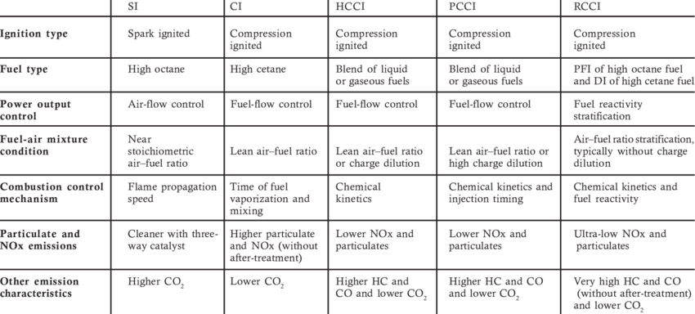
Comparison of SI, CI, HCCI, PCCI and RCCI combustion strategies :
Paykani A, Kakaee A, Rahnama P, Reitz RD. Progress and recent trends in reactivity-controlled compression ignition engines. Int J Engine Res 2016; 17(5):481–524.

Slide 4
Homogeneous Charge Compression Ignition (HCCI):
Introduction to HCCI: Explanation of Homogeneous Charge Compression Ignition (HCCI) as a type of internal combustion process where fuel and air are well-mixed and compressed until auto-ignition occurs, generating heat that can be harnessed for work in a heat engine.
Combination of Gasoline and Diesel Engine Features: Comparison of HCCI with conventional gasoline and diesel engines, highlighting its combination of features such as homogeneous charge and compression ignition.
Fuel Injection in HCCI: Description of fuel injection during the intake stroke in HCCI engines, contrasting with spark ignition used in gasoline engines, and compression ignition in diesel engines.
Comparison with Stratified Charge Compression Ignition: Differentiation between HCCI and stratified charge compression ignition, emphasizing the timing of fuel injection and resulting combustion characteristics.
Control and Emissions in HCCI: Discussion on the necessity of microprocessor control and deep understanding of ignition processes to effectively manage HCCI combustion. Mention of emissions being comparable to gasoline engines but with lower NOx levels.
Emissions Compliance: Note on the emission characteristics of HCCI engines, specifically low NOx emissions without the need for a catalytic converter, while highlighting the necessity to address hydrocarbons and carbon monoxide emissions to comply with automobile emission regulations.

Slide 5
Premixed charge compression ignition (PCCI):
Evolution from HCCI to PCCI: PCCI (Partially Premixed Compression Ignition) originates from HCCI, aimed at improving control over the combustion process, addressing issues like combustion noise and uncontrolled combustion phases.
Controlled Ignition Delay: PCCI achieves the desired ignition delay through various mechanisms, including enhanced charge motion, lower compression ratio, higher injection pressure, and extensive exhaust gas recirculation (EGR).
Fuel Injection Strategies: Fuel injection in PCCI engines can be executed in three primary ways: advanced direct injection, port fuel injection, and late direct injection. Each method has its implications on emissions and combustion characteristics.
Impact of Injection Strategies on Emissions: Advanced direct injection and port fuel injection can lead to increased emissions of hydrocarbons (HC) and carbon monoxide (CO) due to fuel impingement on the cylinder wall. However, techniques such as narrow spray angle injectors and EGR can mitigate this issue, especially in late direct injection.
New Approaches in PCCI: Innovative approaches in PCCI involve air-fuel premixing via early injection, followed by a late injection of fuel pulse during the compression stroke. This method allows for better control over the onset of ignition and promotes a more homogeneous air-fuel mixture, resulting in reduced NOx emissions and soot levels.
Role of Exhaust Gas Recirculation (EGR): Higher levels of EGR in PCCI engines contribute to a longer ignition delay, facilitating better air-fuel mixing and reducing the occurrence of fuel-rich pockets in low-temperature combustion (LTC), ultimately leading to improved emission performance.

Slide 6
Reactivity Controlled Compression Ignition (RCCI):
Description of RCCI Combustion: RCCI (Reactivity Controlled Compression Ignition) compression involves compressing a well-mixed low-reactivity fuel and oxidizer, such as air, without initiating auto-ignition.
Injection of High-Reactivity Fuel: During the compression cycle, high-reactivity fuel is injected to create a localized mixture of low and high reactivity fuels.
Ignition of Entire Fuel Charge: High-reactivity fuel is injected near the piston's top dead center, initiating combustion of the entire fuel charge.
Dual-Fuel Requirement: RCCI combustion necessitates the use of two distinct fuels: low-reactivity fuel injected into the intake ports and high-reactivity fuel injected into the cylinder.
Throttle-Free Operation: Unlike Otto engines, RCCI does not require a throttle due to its reliance on compression ignition. This characteristic closely resembles the diesel combustion process.
Emission and Efficiency Benefits: RCCI engines can achieve ultra-low NOx and soot emissions, along with high thermal efficiency, compared to conventional diesel combustion, making them a promising technology for reducing environmental impact.

Slide 7
HCCI operation with alternative fuels:
Impact of Fuel Blends on HCCI Performance: Experimental tests conducted with five fuel blends in port fuel-injected HCCI (PFI-HCCI) aim to assess the effects of cetane number, fuel-bound oxygen content, and volatility on HCCI challenges, including narrow load range and emissions.
Emission Comparison: In HCCI mode, all tested fuels exhibit significantly lower NOx and smoke emissions compared to conventional diesel combustion (CDC), emitting less than 40 ppm of NOx and less than 0.1 FSN of smoke.
Cetane Number Enhancement: Adding an ignition improver (EHN) to gasoline enhances its cetane number, with different concentrations resulting in varying cetane numbers. Higher cetane numbers improve combustion and reduce HC emissions but can lead to increased NOx emissions due to higher in-cylinder temperatures.
Impact of Oxygenated Butanol: Butanol, added to gasoline-EHN blends, improves combustion by providing fuel-bound oxygen, resulting in higher peak pressure, earlier combustion phasing, and reduced emissions of HC, NOx, and smoke. However, it affects the engine's operable load range due to its higher latent heat of vaporization.
Effect of Fuel Volatility: Blends with lower volatility than gasoline, such as diesel and Karanja biodiesel, exhibit poor combustion, leading to reduced brake thermal efficiency (BTE) and increased HC and smoke emissions. Optimal fuel volatility is crucial for efficient HCCI operation.

Slide 8
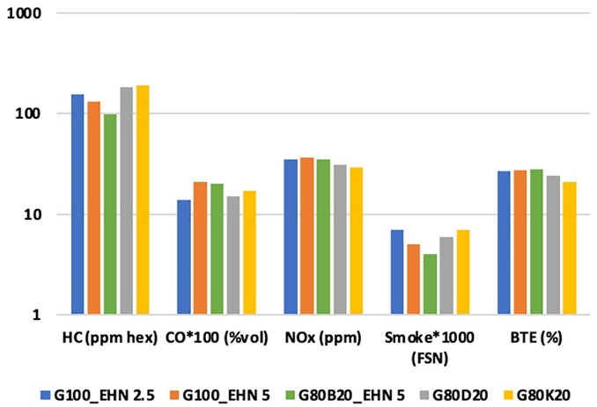
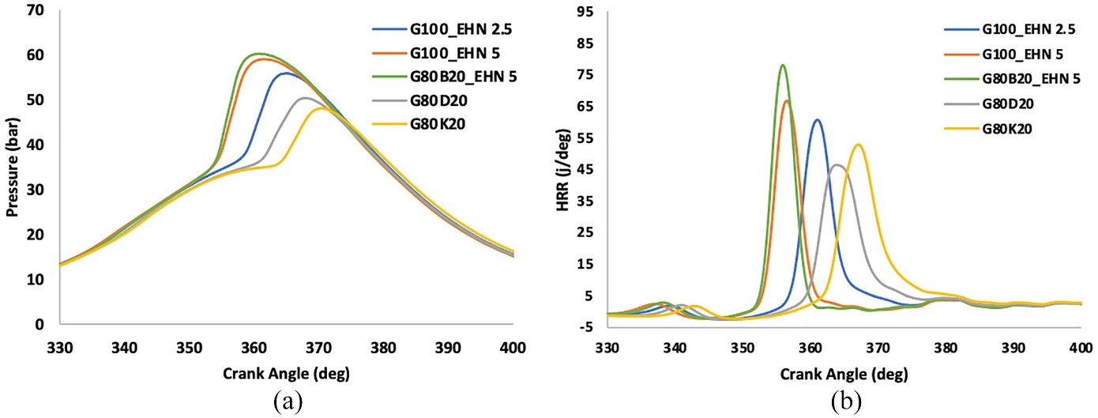
6. Optimal Fuel Blend: Gasoline with 5% EHN (G100EHN5) demonstrates superior performance in terms of maximum operable load range, BTE, and HC emissions compared to other fuel blends, highlighting the importance of fuel composition in achieving efficient HCCI combustion.
Figure :. Comparison of pressure (a) and HRR
(b)profiles with alternative fuels PCCI mode at 60% load condition.
Krishnasamy A, Gupta SK, Reitz RD. Prospective fuels for diesel low temperature combustion engine applications: a critical review. Int J Engine Res 2021; 22(7): 2071–2106.
.

Slide 9
PCCI operation with alternative fuels:
PCCI Operation Overview: Partially Premixed Compression Ignition (PCCI) achieves low-temperature combustion by advancing fuel injection timing and employing Exhaust Gas Recirculation (EGR).
Impact of Alternative Fuels: The study examines the effects of cetane number and oxygenated alternative fuels on the operating load range and emissions in early direct injection (DI) compression ignition mode.
Fuel Blends: High volatile and low reactive gasoline and butanol are blended with diesel at various proportions to alter fuel reactivity and volatility, affecting combustion characteristics.
Pressure and HRR Profiles: Blending gasoline and butanol with diesel results in delayed ignition, altered combustion phasing, and lower maximum pressure, impacting combustion dynamics as indicated by pressure and heat release rate profiles.
Exhaust Emissions: Blending alternative fuels such as butanol or gasoline with diesel improves fuel volatility and reduces NOx emissions, although effects on HC and CO emissions vary. Optimal fuel injection timing is crucial for managing combustion phasing.

Slide 10
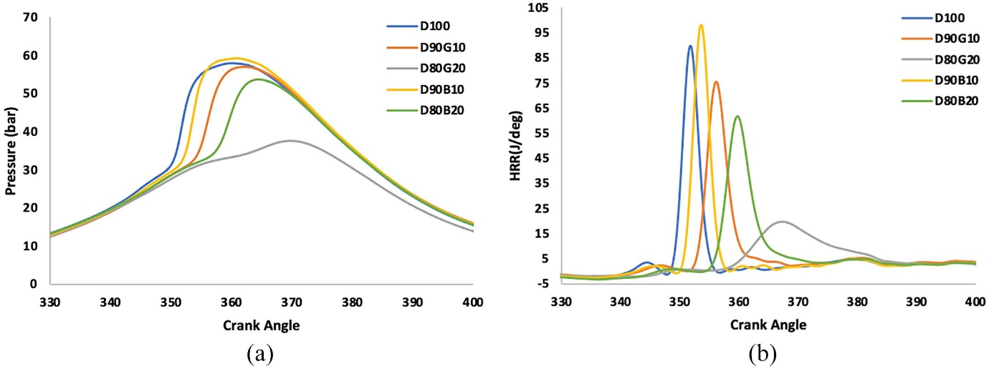
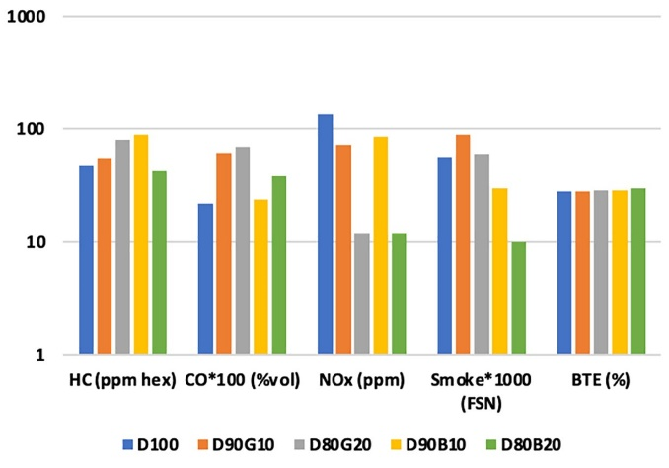
6. Operational Load Range: Operational load range analysis reveals that achieving higher loads in early DI combustion mode is challenging, with only specific fuel blends, notably D80B20 (20% butanol blend), demonstrating significantly lower NOx and smoke emissions, indicating successful PCCI combustion at higher loads.
Figure :. Comparison of pressure (a) and HRR
(b)profiles with alternative fuels PCCI mode at 60% load condition.
Asad U, Divekar P, Zheng M, Tjong J. Low temperature combustion strategies for compression ignition engines: operability limits and challenges. SAE International 2013; 2013-01-0283.

Slide 11
RCCI operation with alternative fuels:
RCCI Investigation of Alternative Fuels: Alternative fuels are explored for port-injected low-reactivity and direct-injected high-reactivity fuels in Reactivity Controlled Compression Ignition (RCCI) combustion to mitigate high HC and CO emissions.
Operational Range and Fuel Sensitivity Studies: The engine demonstrates operability across the load range in RCCI with all tested fuels. Fuel sensitivity studies examine the effects of cetane number and oxygenated alternative fuels on engine performance and emissions.
Port Fuel Injection (PFI) Alternative Fuels: Butanol and ethanol blends are compared to gasoline as PFI alternative fuels. Gasoline-butanol blends show reduced peak pressure and delayed combustion, resulting in lower HC and CO emissions due to butanol's fuel-bound oxygen content.
Direct Injection (DI) Alternative Fuels: Butanol, gasoline, and Karanja biodiesel blends with diesel are tested for DI fuel sensitivity. Low-reactivity butanol-gasoline blends cause delayed combustion, while high-reactivity Karanja biodiesel promotes early low-temperature heat release.

Slide 12
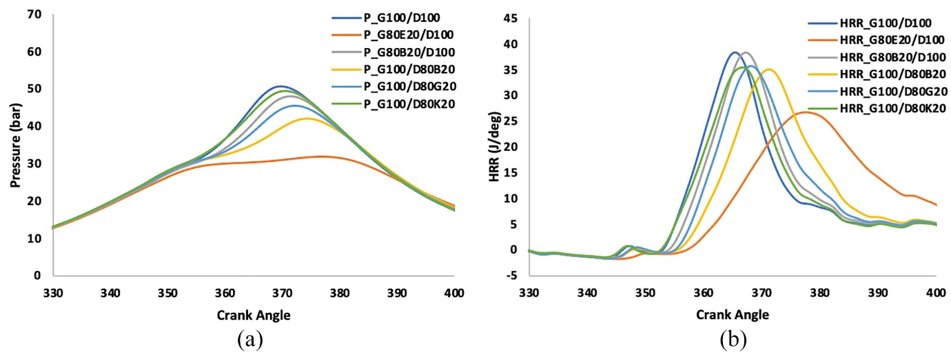
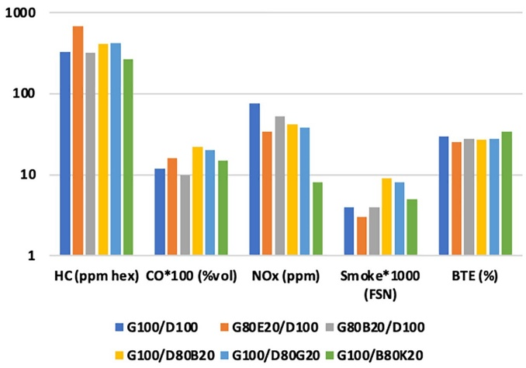
5. Exhaust Emissions and Performance: Butanol and gasoline blends emit more HC and CO compared to diesel RCCI due to delayed combustion. Karanja biodiesel-diesel blend demonstrates reduced HC emissions and better Brake Thermal Efficiency (BTE) compared to diesel.
6. Comparison of LTC Strategies with Alternative Fuels: HCCI, PCCI, and RCCI combustion strategies with alternative fuels are compared. RCCI with Karanja biodiesel-diesel blend emerges as the most effective strategy for reducing emissions and improving engine performance.
Figure :. Comparison of pressure (a) and HRR
(b)profiles with alternative fuels in PCCI mode at 60% load condition.
Dempsey AB, Curran SJ, Wagner RM. A perspective on the range of gasoline compression ignition combustion strategies for high engine efficiency and low NOx and soot emissions: effects of in-cylinder fuel stratification. Int J Engine Res 2016; 17: 897–917.

Slide 13
Challenges associated with HCCI, PCCI and RCCI strategies :
Property | HCCI | PCCI | RCCI
Operational challenge | Limited load range, combustion phasing and ignition control | High EGR requirement, Limited load range | PFI to DI ratio optimization
Emission challenge | High HC and CO | High HC, CO, and smoke | High HC and CO
Fuel reactivity | Moderate | Moderate | PFI: low DI: High
Volatility | High | Optimal | PFI: high DI: Low
Suitable fuels | Butanol, gasoline with additive | Butanol and gasoline blends with diesel | PFI: alcohol fuels, DI: biodiesel
Dempsey AB, Walker NR, Reitz RD. Effect of cetane improvers on gasoline, ethanol, and methanol reactivity and the implications for RCCI combustion. SAE Int J Fuel Lubricants 2013; 6(1): 170–187.

Slide 14
Conclusions:
Comparison of LTC Strategies with Conventional Combustion: HCCI, PCCI, and RCCI strategies are compared to conventional diesel combustion, highlighting their benefits in terms of reduced NOx and smoke emissions, increased thermal efficiency, and lower unburned emissions.
Operable Load Range and Limitations: HCCI faces operability limits at low loads due to misfire and at high loads due to knocking combustion. PCCI is limited by knocking combustion at high loads, while RCCI demonstrates a wider operating load range.
Combustion Characteristics: HCCI exhibits the earliest Low-Temperature Heat Release (LTHR), followed by RCCI and then PCCI. HCCI achieves complete premixing, while RCCI and PCCI have partial premixing due to in-cylinder injection and shorter fuel-air mixing times.
Pressure Profiles and Emission Reduction: LTC strategies show smoother pressure profiles compared to conventional combustion, with HCCI excelling in reducing HC and CO emissions, and PCCI performing better in terms of Brake Thermal Efficiency (BTE).
Impact of Alternative Fuels: Butanol and cetane improvers in gasoline during HCCI reduce emissions and improve BTE. In PCCI, blending low-reactivity, high-volatility fuels with diesel delays combustion, with the D80B20 blend showing reduced emissions and improved BTE.

Slide 15
6. PFI and DI Fuel Blends in RCCI: Gasoline-butanol blends as Port Fuel Injection (PFI) reduce HC and CO emissions significantly in RCCI. Butanol-gasoline blends improve BTE, while diesel-Karanja blends as Direct Injection (DI) reduce emissions and improve BTE.
7. Impact of Fuel Reactivity and Combustion: Variations in fuel reactivity have a greater impact on combustion and emissions than volatility in RCCI. Prolonged combustion in RCCI leads to lower BTE but wider operable load range and improved BTE at higher loads.
8. Optimal LTC Strategy for Load Range: PCCI is optimal for low-load range operations, while RCCI is better suited for high-load operations due to its longer combustion time.

Slide 16
Thanks

